Slide 1

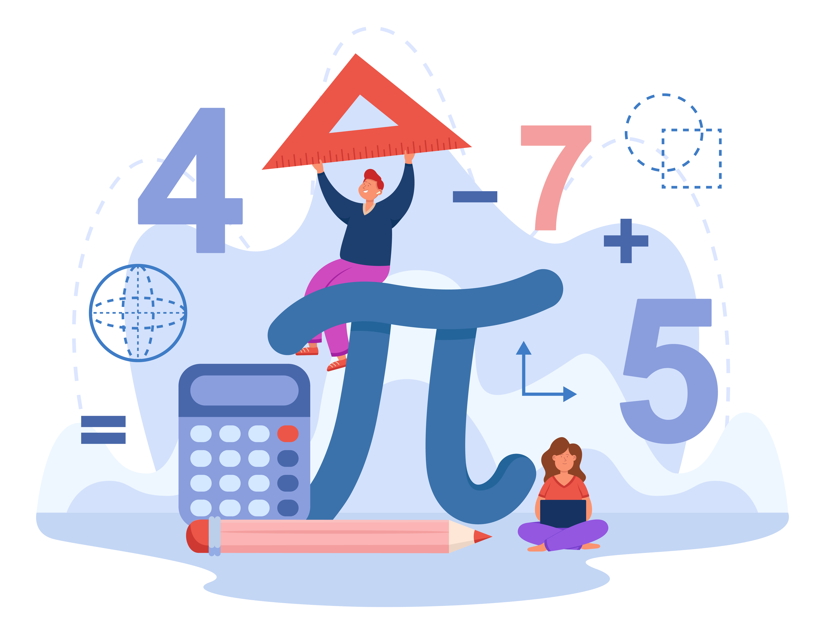


CALCURE

Slide 2


Our Team - C
Mishu Akter
Roll : NFH2325007F
Md. Ariful Islam
Roll : MUH2325010M
Claudia Alves
Ishrat Zaman
Roll : NFH2325021F
Mohammed Karimul Mowla
Roll : ASH2325031M

Slide 3
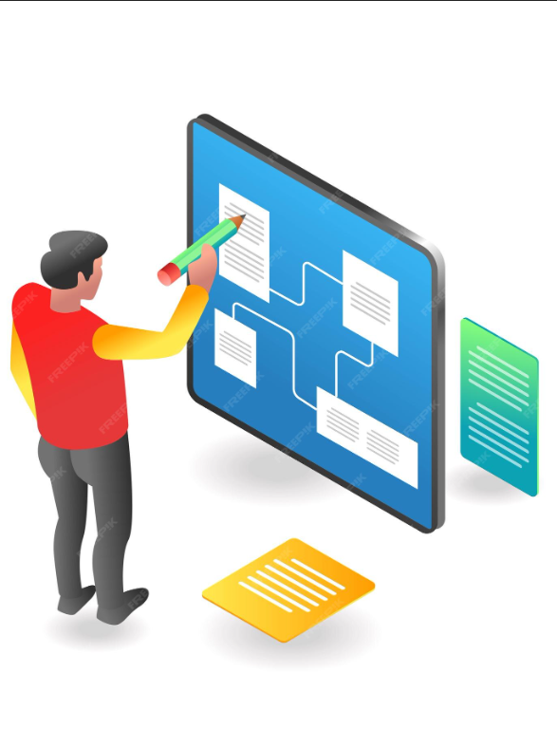
Overview
Introduction
Key Features
Stakeholders
Requirement Elicitation Techniques
Preliminary Concept vs.
Finalized Concept
Stakeholders Engagement
Project Scenarios
Data Flow Diagram
Use Case Diagram
Activity Diagram
Conclusion

Slide 4
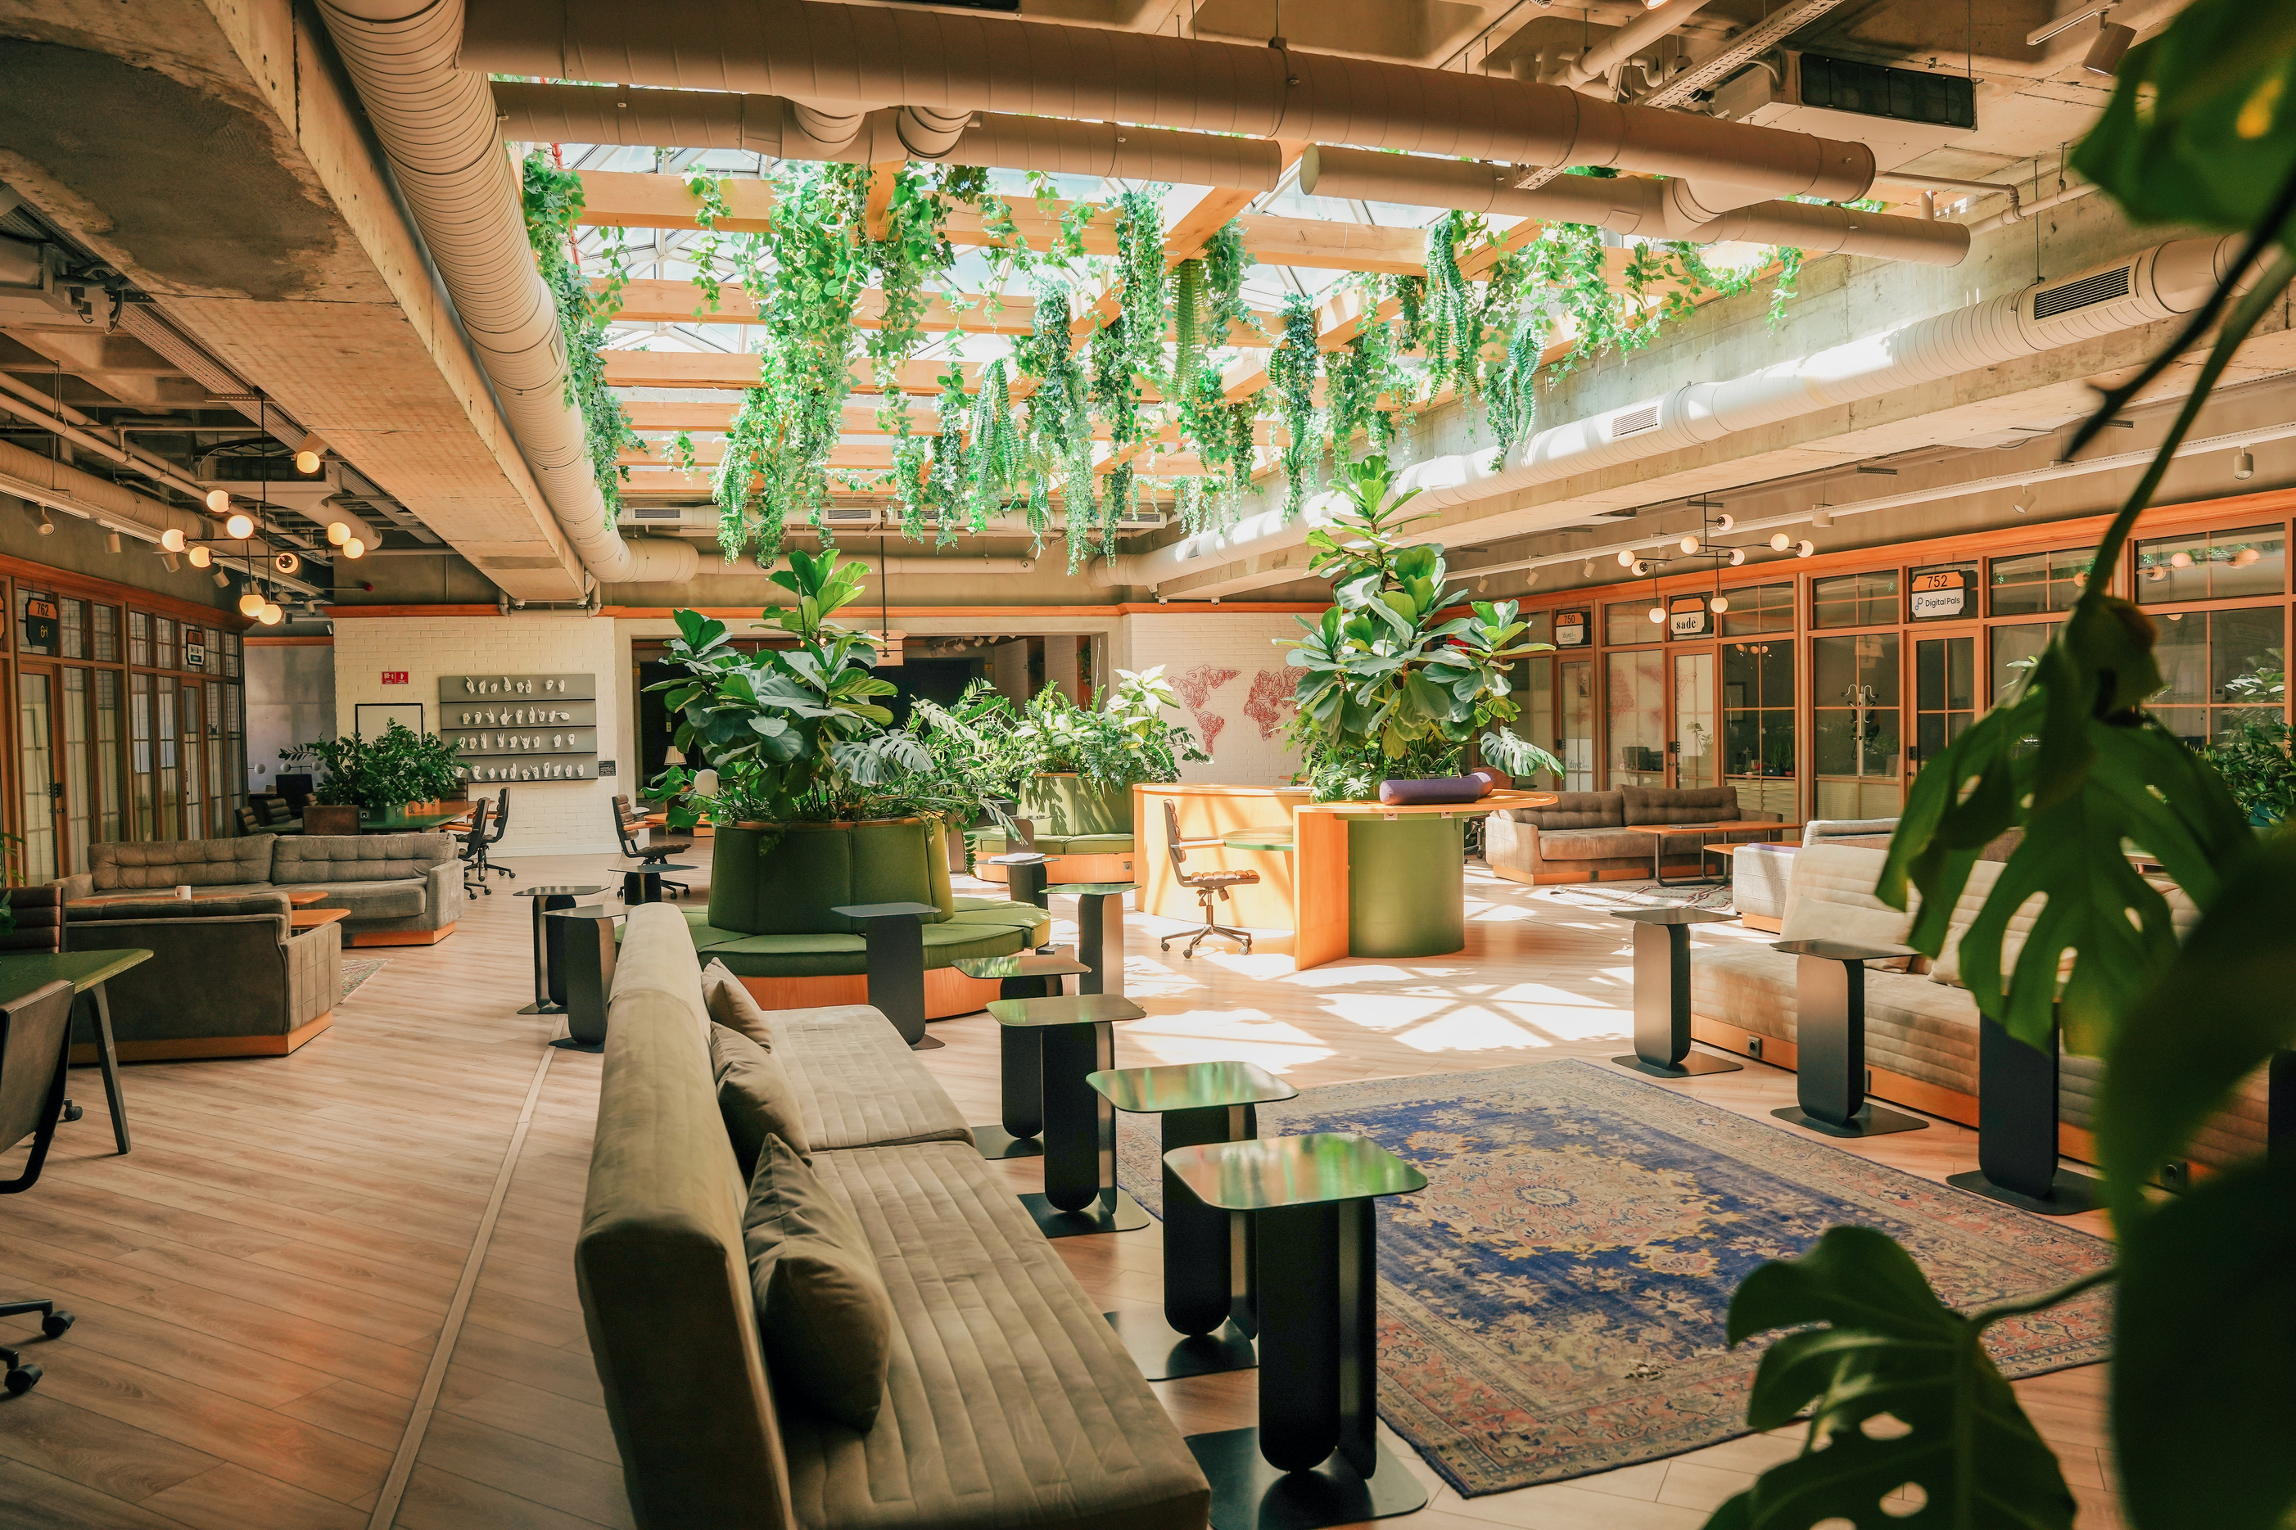

The Problem
The Solution: “Calcure”
Many students struggle with understanding mathematical concepts due to a lack of clear explanations, limited practice opportunities, and insufficient feedback. Traditional learning methods often fail to track individual progress, identify weak areas, or adapt to different learning speeds. As a result, students lose confidence and perform poorly in mathematics.
Calcure is an intelligent mathematics learning platform designed to improve conceptual understanding and problem-solving skills. It provides structured lessons, interactive exercises, step-by-step solutions, and instant feedback. Calcure supports multiple difficulty levels and bilingual content (Bengali/English), making mathematics learning accessible, engaging, and effective for students.

Slide 5
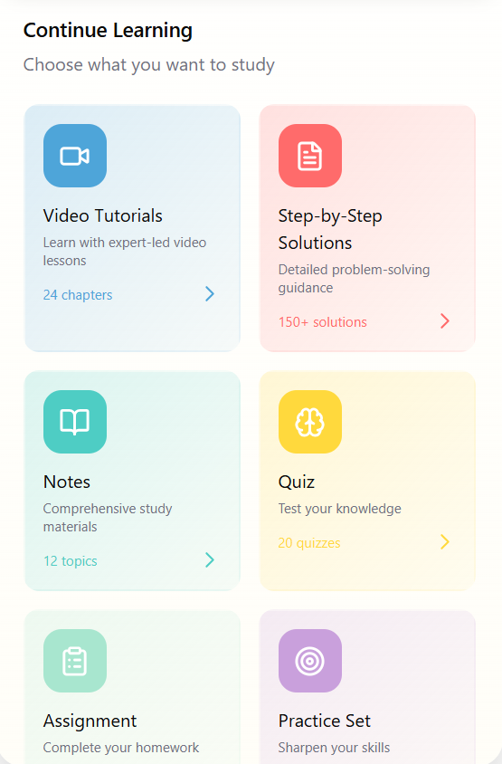
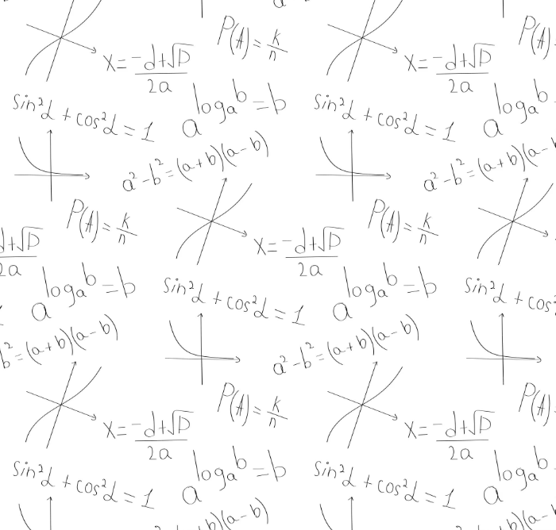

Key Features!
Step-by-step solutions to math problem
Video tutorials for better understanding
Interactive visualizations: animated diagrams & graphs
Chapter-wise quizzes & tests for progress tracking

Slide 6


Stakeholders
Student:
Uses the system responsibly for learning and practice.
Teacher:
Creates and manages accurate learning content.
Moderator:
Ensures content quality and policy compliance.
System Administrator:
Responsible for managing system operations, security, user roles, and overall platform stability.
Job Seeker:
Applies for roles with valid information.
Guardian:
Responsible for monitoring student progress and supporting consistent learning behavior.
Educational Partner Platform:
Provides verified educational resources.
Project Owner :
Responsible for providing strategic oversight and approving major system decisions and enhancements.

Slide 7
Requirement Elicitation Techniques
Techniques | Primary Student | Primary Teacher | Secondary Student | Secondary Teacher | Higher-Secondary Student | HIgher-Secondary Teacher
Interview | ❌ | ✓ | ✓ | ✓ | ✓ | ✓
Workshops | ✓ | ✓ | ✓ | ✓ | ✓ | ✓
Focus Group | ❌ | ❌ | ✓ | ✓ | ✓ | ✓
Observations | ✓ | ✓ | ✓ | ✓ | ✓ | ✓
Questionaries | ✓ | ✓ | ✓ | ✓ | ✓ | ✓
User Interface Analysis | ❌ | ❌ | ✓ | ✓ | ✓ | ✓

Slide 8
Preliminary Concept vs. Finalized Concept
Stage | Description
Preliminary Concept | Initial meetings with students, teachers, and parents identified key learning challenges across different levels. Students struggle with basic operations and often memorize formulas without understanding concepts. Teachers face difficulty explaining fundamentals, highlighting the need for step-by-step visuals and interactive learning.
Finalized Concept | Based on requirement analysis, Calcure was finalized as a visualization-driven mathematics learning platform. The system emphasizes step-by-step problem solving, conceptual explanations, and derivation-based learning to strengthen foundational understanding.Calcure supports learners from primary to higher secondary levels by combining interactive practice, visual demonstrations, and guided explanations, ensuring both conceptual clarity and long-term retention of mathematical concepts.

Slide 9
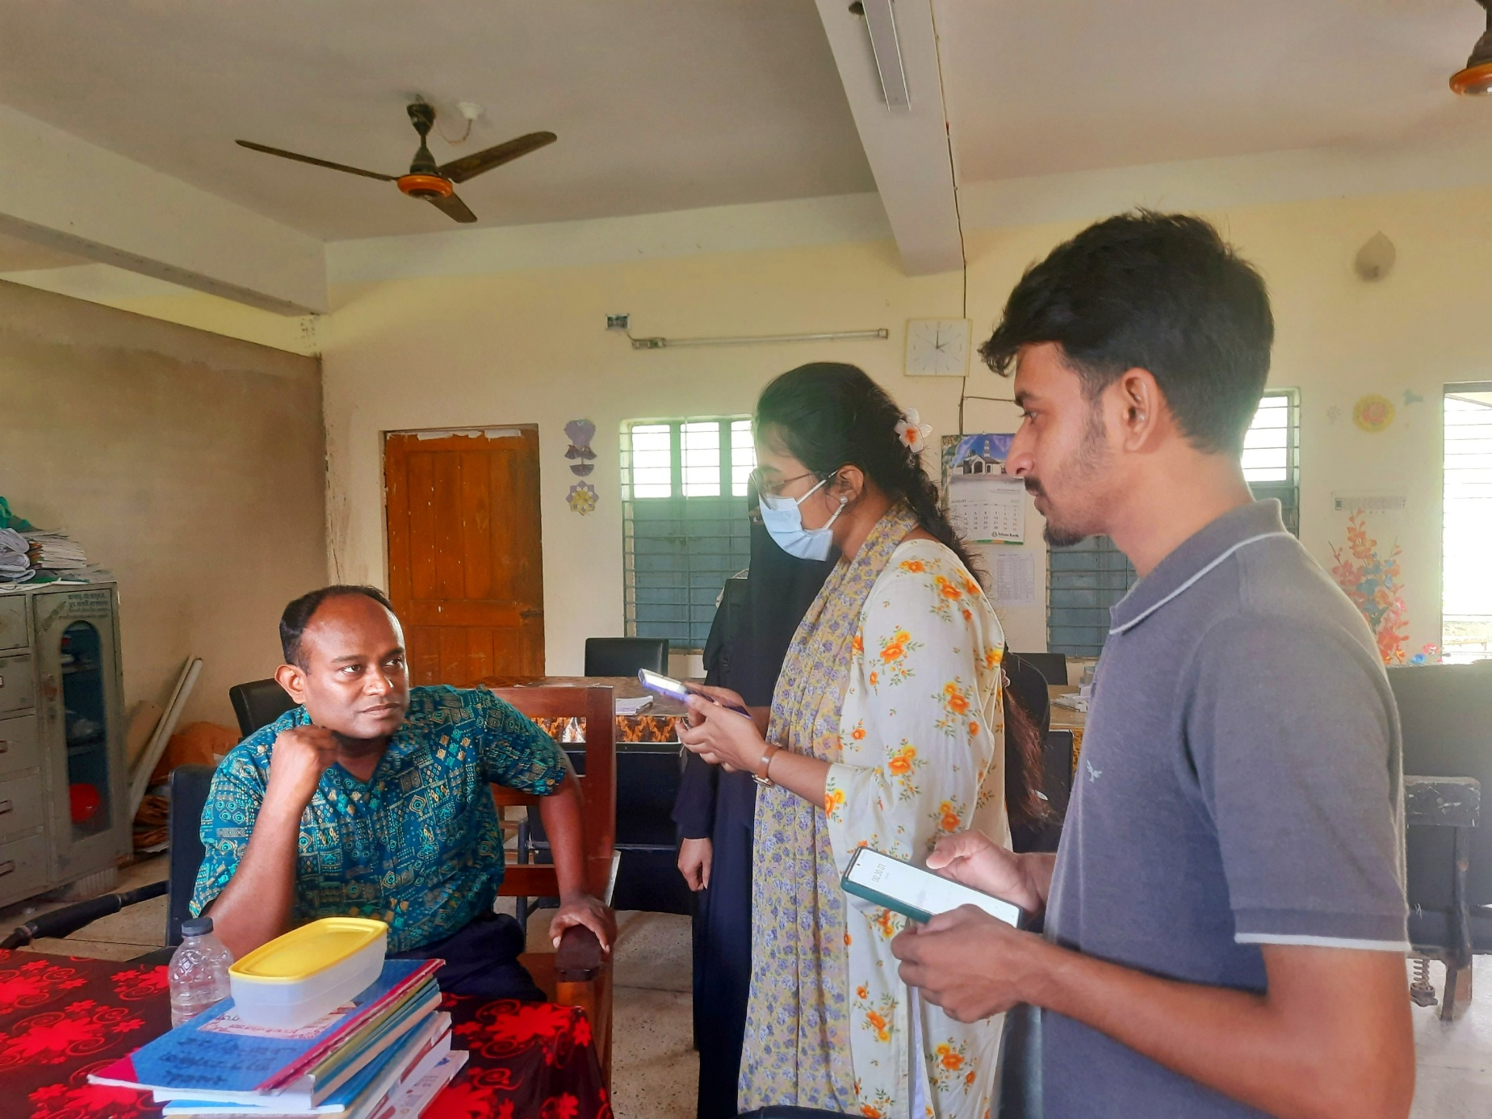
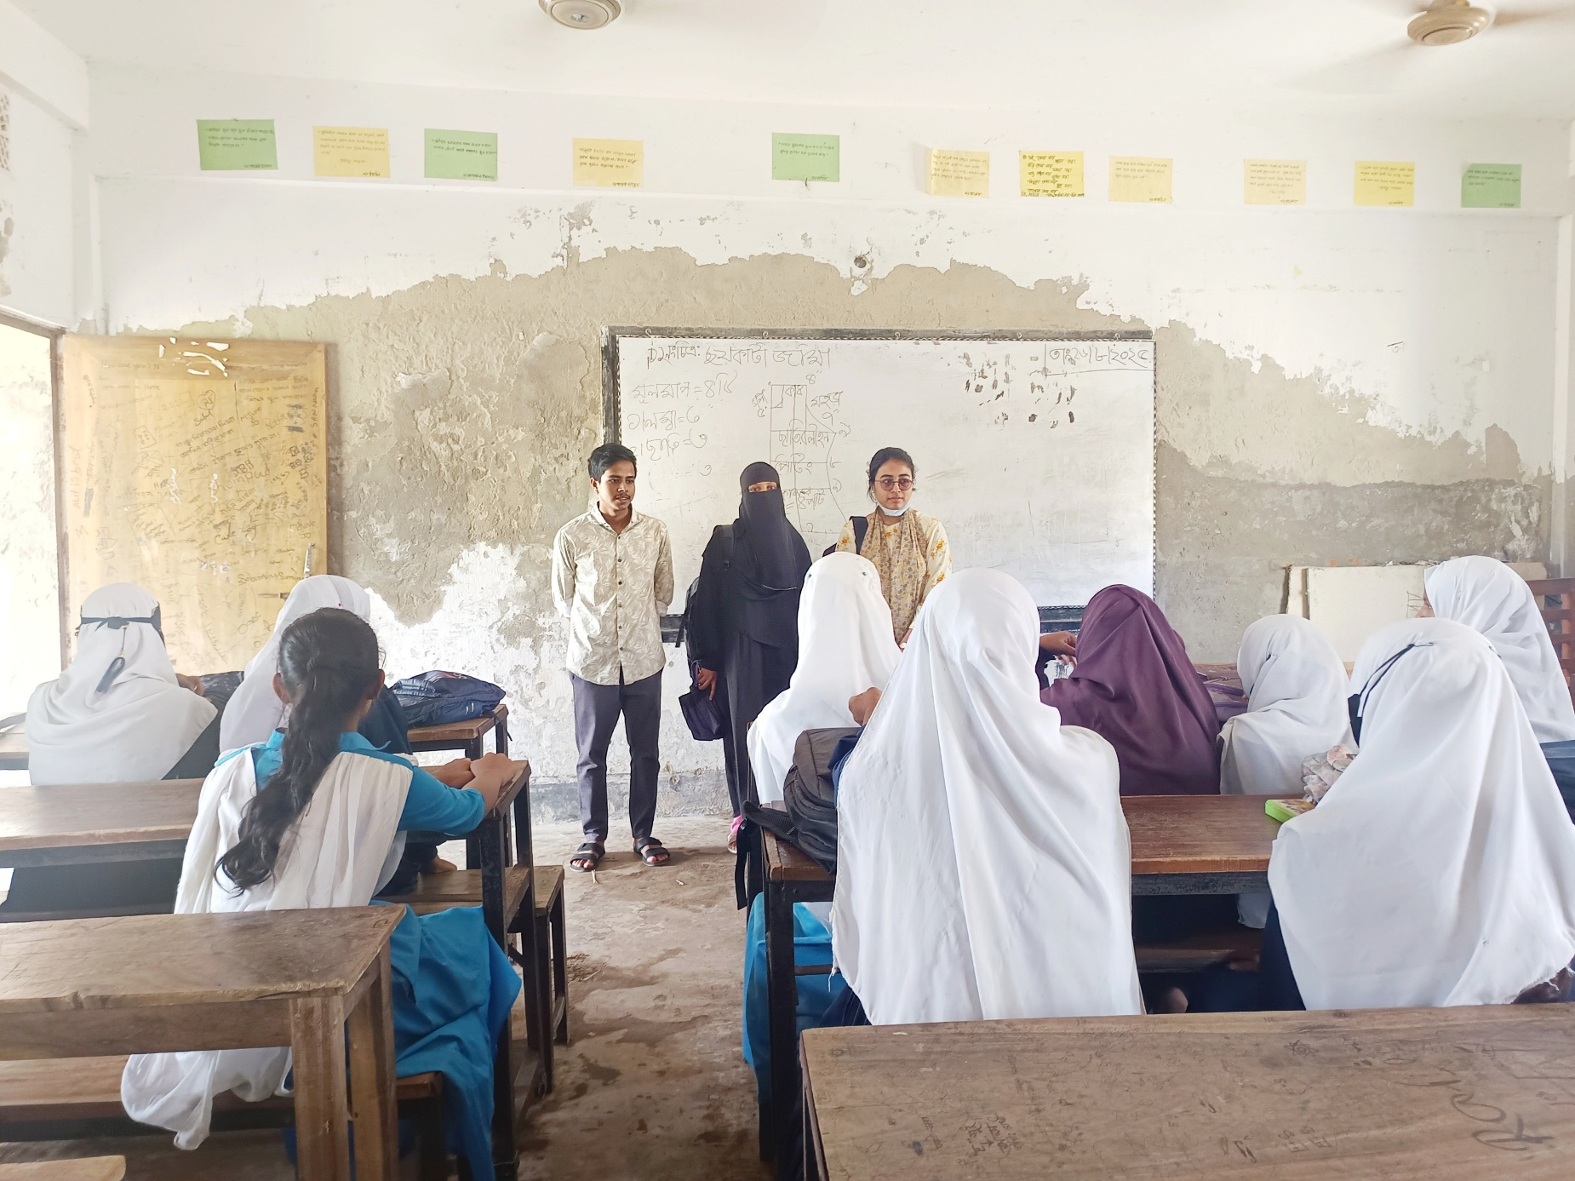
Stakeholders Engagement
Moahmmad NurNabi
Assistant Teacher ( Math )
Primary Section
Banglabazar High School, Noakhali
Engagement with students of class 6-8
At Banglabazar High School, Noakhali

Slide 10
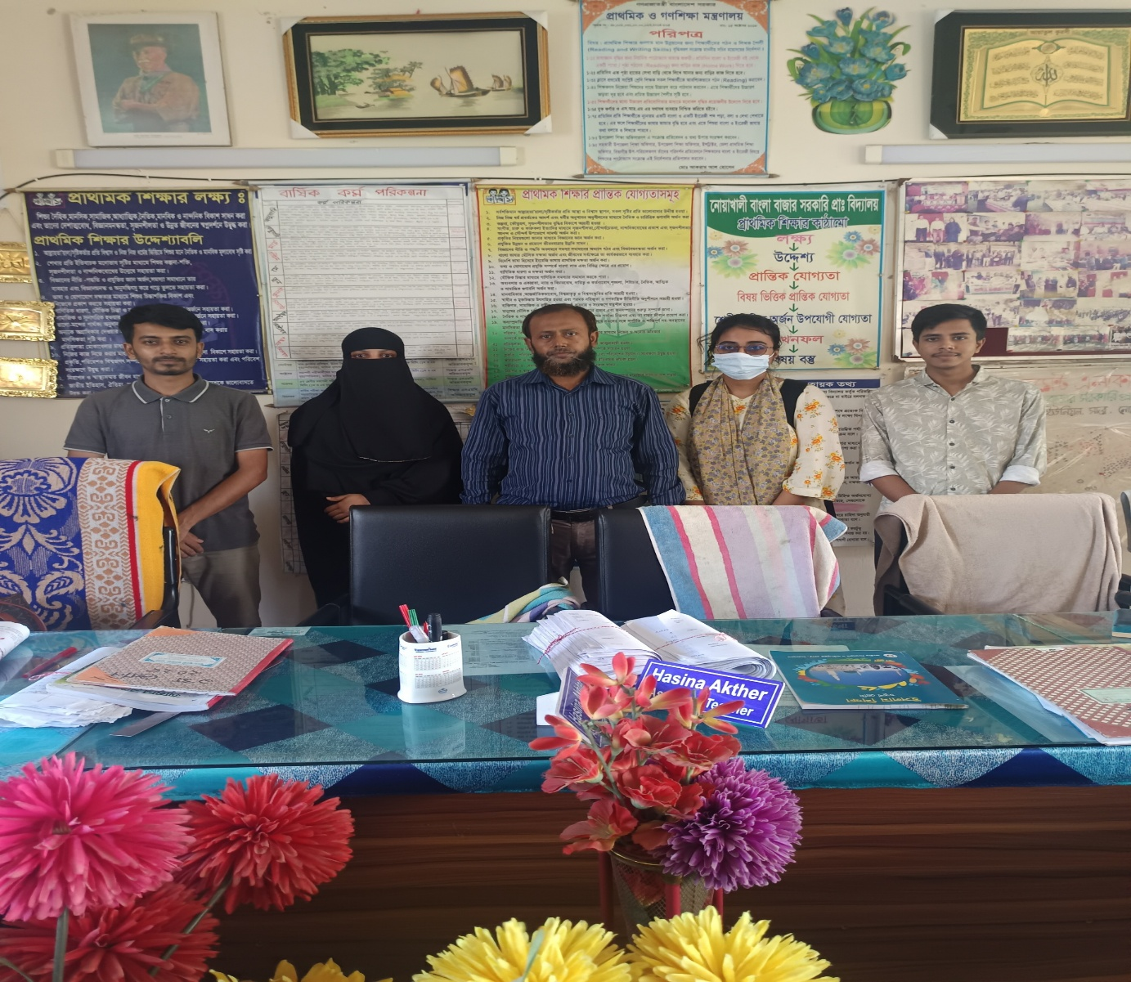
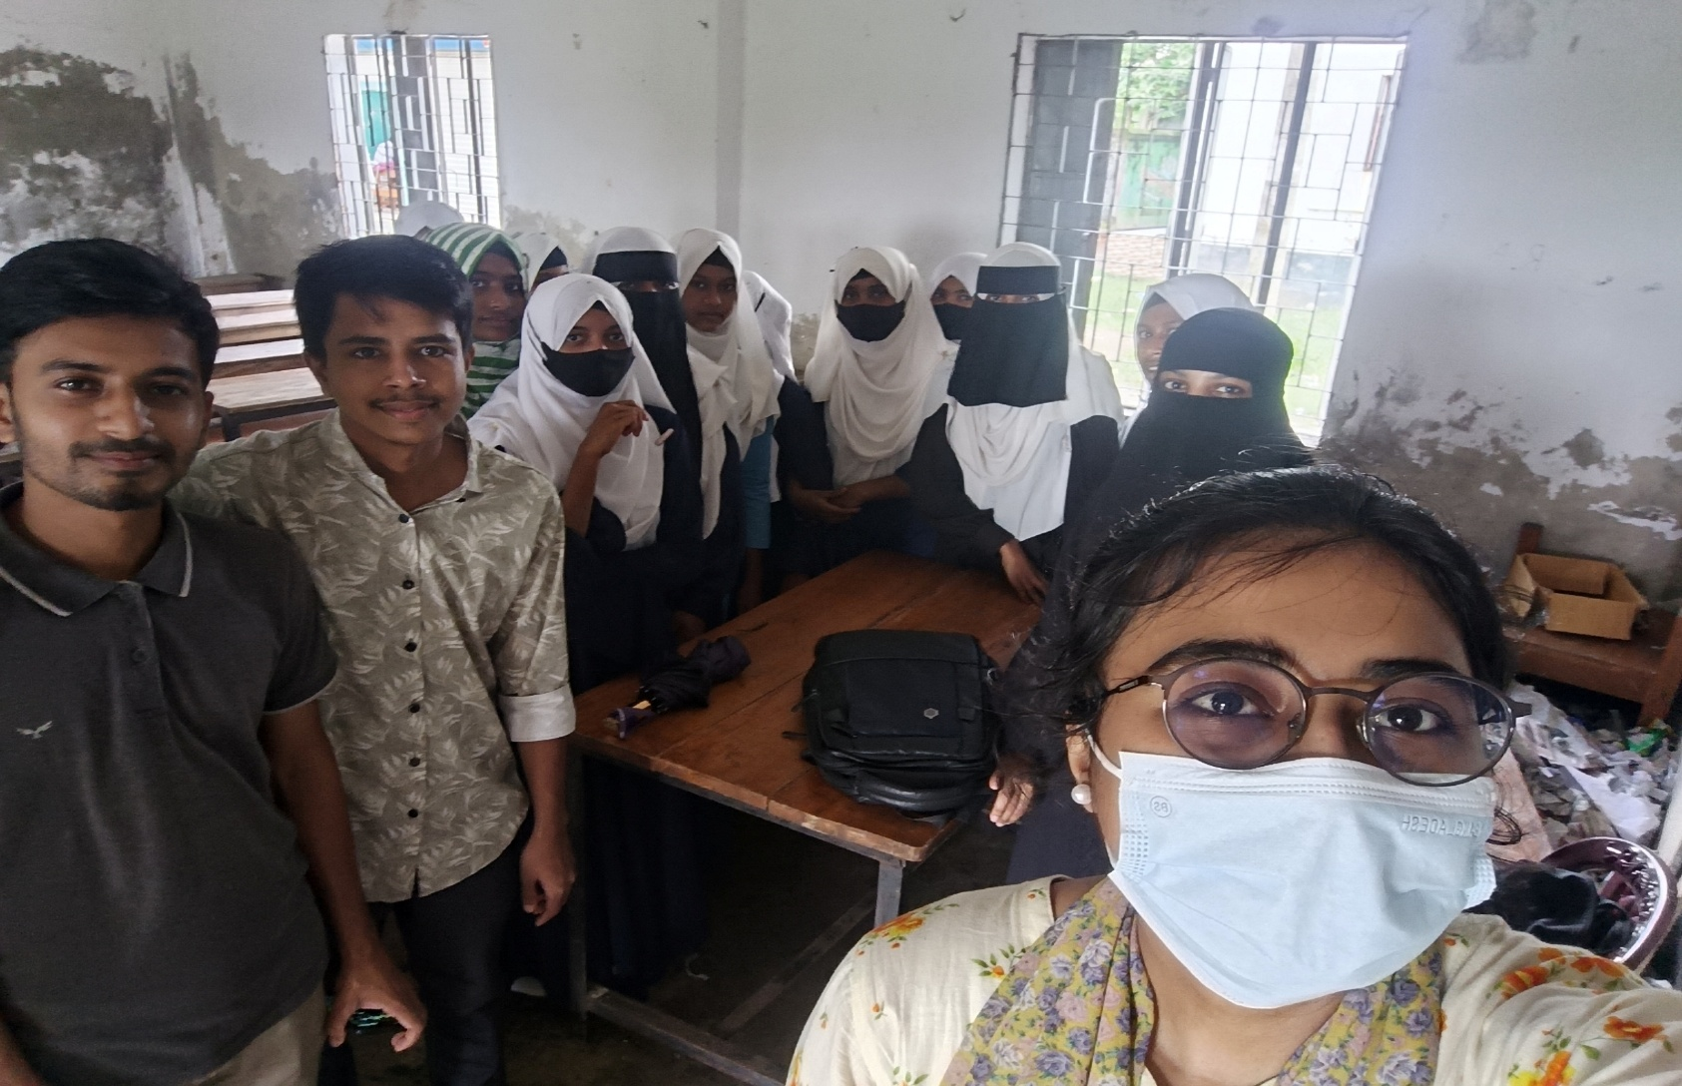
Stakeholders Engagement
Md Ashiqullah
Assistant Teacher ( Math )
High School Section
Banglabazar High School, Noakhali
Engagement with students of class 9-10
At Banglabazar High School, Noakhali

Slide 11
Project Scenarios
Scenario 1: Primary Learner (Grade 1–5): Arif Learns Geometry with Calcure
Context: Arif is a Class 3 student. He uses Calcure on a tablet at home to learn math in a fun and easy way. His account is connected to his parent’s account.
Scenario 1a: Learning with visuals and practice
Arif opens Calcure and logs in with his account.
He chooses Class 3 → Geometry → Shapes.
The app shows a short animated video in Bangla explaining shapes like triangles and squares.
Arif moves and touches shapes on the screen to understand them better.
After the lesson, Calcure gives him a few simple practice questions.
When Arif answers correctly, the app gives instant feedback and a happy animation.
When he gets stuck, Calcure shows a small hint with pictures to help him.
At the end, Arif sees his score and progress, and earns a star.

Slide 12
Project Scenarios
Scenario 1b: Homework assigned by teacher
Arif gets a notification on his tablet saying his teacher has given homework on shapes.
He opens the app and sees the homework questions.
Arif chooses “Remind me later” because he wants to play first.
After some time, the app reminds him again.
He completes the homework, and the result is automatically sent to the teacher.
His parent can also see his progress in their account.
Scenario 1c: Learning with low internet
Sometimes Arif’s internet is slow.
Calcure allows him to download lessons earlier when internet is available.
Arif studies and solves problems without internet.
When the internet comes back, the app automatically updates his progress and rewards.

Slide 13
Project Scenarios
Scenario 2: Secondary Student (Class 6–10): Sara Improves Algebra Skills
Context: Sara is a Class 8 student. She studies math on her mobile phone to prepare for school exams and understand difficult topics better.
Scenario 2a: Step-by-step problem solving
Sara opens Calcure and logs in.
She selects Class 8 → Algebra → Linear Equations.
The app shows a short video explaining the concept in Bangla.
Sara tries a practice problem.
Calcure solves the problem step by step, showing how each line is derived.
When Sara makes a mistake, the app highlights where she went wrong.
She retries and answers correctly, gaining confidence.
Scenario 2b: Exam preparation and progress tracking
Sara switches to Exam Mode before a class test.
She solves timed questions with easy, medium, and hard levels.
After finishing, Calcure shows her accuracy, weak areas, and suggestions.
She revises weak topics using recommended videos and visuals.

Slide 14
Project Scenarios
Scenario 3: Higher Secondary Student (Class 11–12): Rafi Understands Trigonometry
Context: Rafi is an HSC student preparing for board exams and admission tests. He struggles with understanding where formulas come from.
Scenario 3a: Conceptual learning with visualization
Rafi opens Calcure and selects Class 11 → Trigonometry → Formula Derivation.
The app shows animated diagrams explaining how formulas are derived.
Each step is explained clearly with visual movement and narration.
Rafi finally understands the logic behind the formulas.

Slide 15
Project Scenarios
Scenario 3b: Practice with explanation
Rafi solves trigonometry problems.
Instead of only showing the answer, Calcure shows full derivation steps.
He can pause, replay, or jump to any step.
This helps him remember formulas during exams.
Scenario 3c: Performance analysis
After practice, Calcure shows Rafi a performance summary.
The app highlights which formulas he struggles with most.
Rafi follows the suggested lessons and improves steadily.

Slide 16

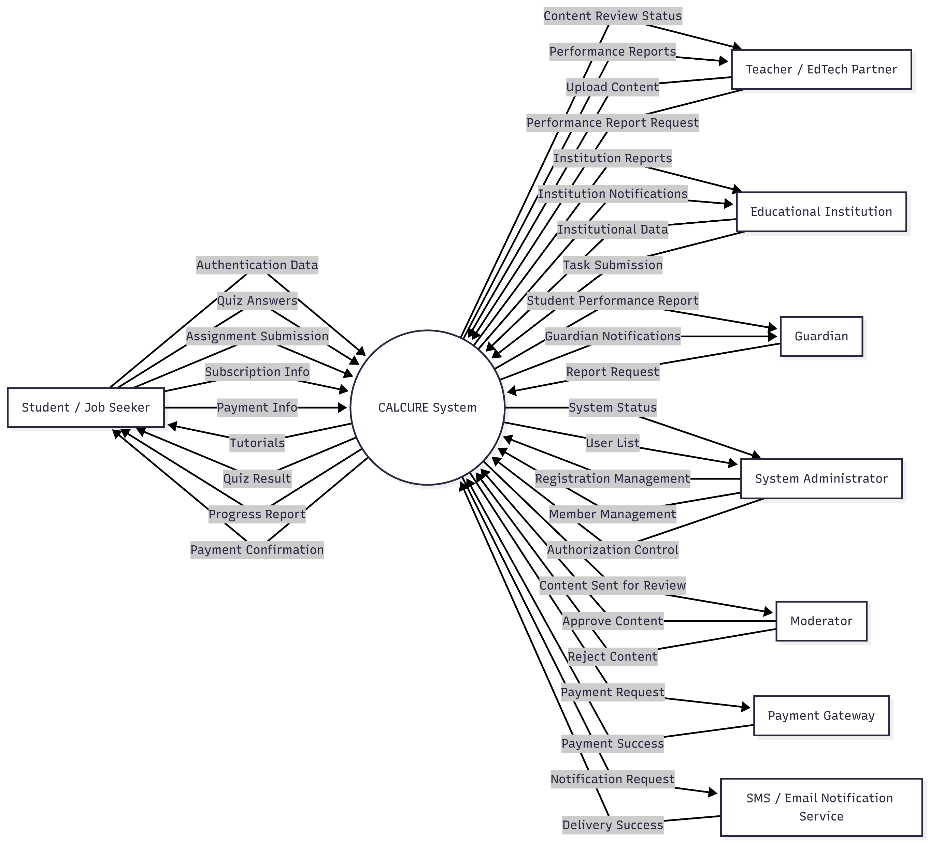

Data Flow Diagram
LEVEL 0

Slide 17
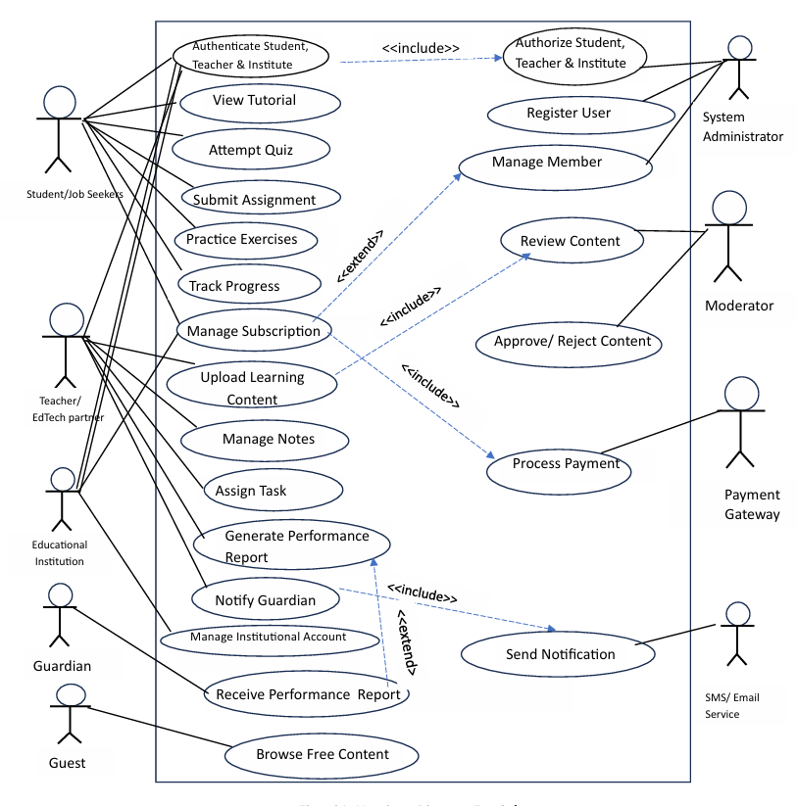
Use-Case Diagram for “Calcure”

Slide 18
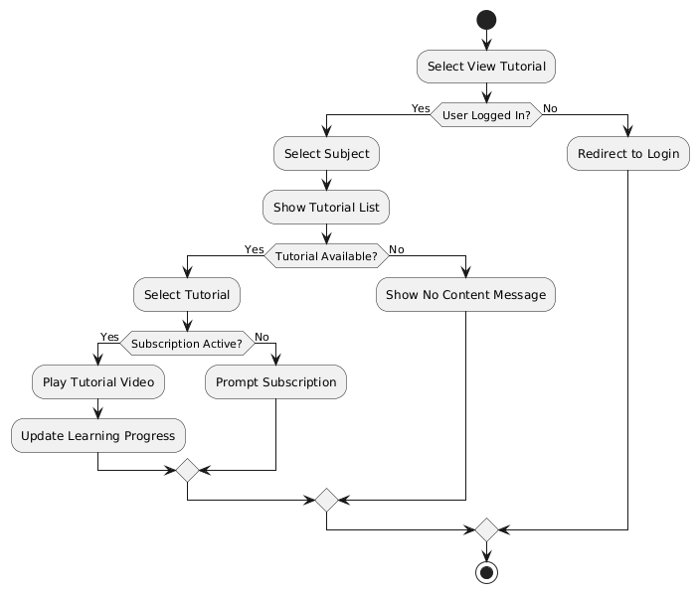
Activity diagram for “View tutorial”

Slide 19
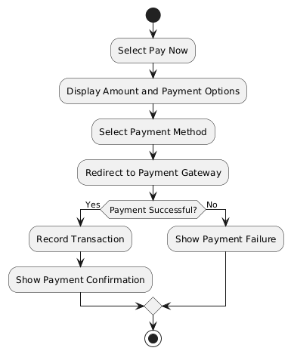
Activity diagram for “Process payment”

Slide 20
Functional Requirements
FR-1: User Registration & Authentication
FR-2: Learning Content Access
FR-3: Practice & Feedback
FR-4: Progress Tracking & Reporting
FR-5: Content Management (Teacher)
FR-6: Content Moderation
FR-7: Administration
FR-8: Job Application Management
FR-9: Language & Accessibility

Slide 21
Non-Functional Requirements
NFR-1: Performance
NFR-2: Usability
NFR-3: Reliability & Availability
NFR-4: Security
NFR-5: Scalability
NFR-6: Maintainability
NFR-7: Compatibility
NFR-8: Legal & Ethical Compliance

Slide 22
Conclusion
Calcure is designed to be an effective and student-centered mathematics learning application for students from class 1 to 12. Through stakeholder discussions with primary and high school teachers, the project identified key challenges in mathematics education, including lack of engagement, difficulty in understanding concepts, and limited access to guided practice.
The proposed features—such as gamified learning for younger students, step-by-step solutions for advanced topics, bilingual (Bangla and English) support, and progress tracking—aim to address these challenges in a practical and inclusive way. Emphasis on user-friendly design and offline accessibility ensures that Calcure can benefit students from diverse backgrounds.
By incorporating real feedback from educators and focusing on both engagement and conceptual clarity, Calcure has strong potential to enhance mathematical understanding and learning outcomes. The project will move forward with prototype development and continued stakeholder collaboration to ensure the app is educationally effective and widely accessible.

Slide 23
THANK YOU

